Slide 1
Belmont Athletic Awards 2012-13

Slide 2
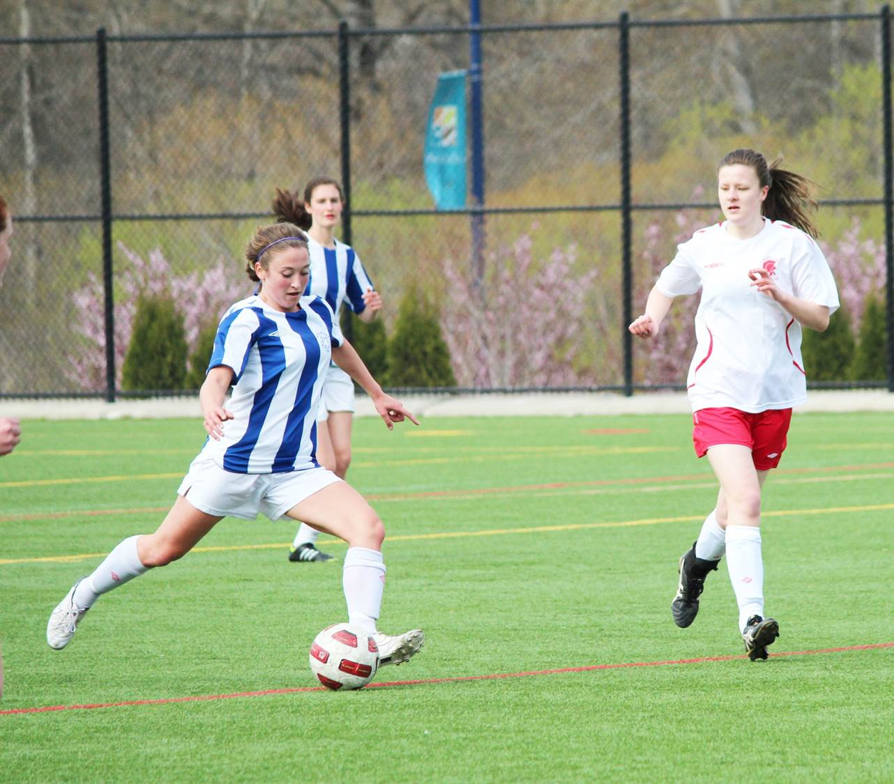
Top Scholar-Athlete
Kristen Livingstone

Slide 3
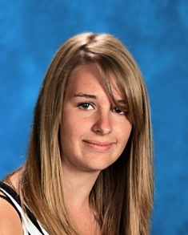
Lloyd Powell Service Award
Brianna Richards

Slide 4
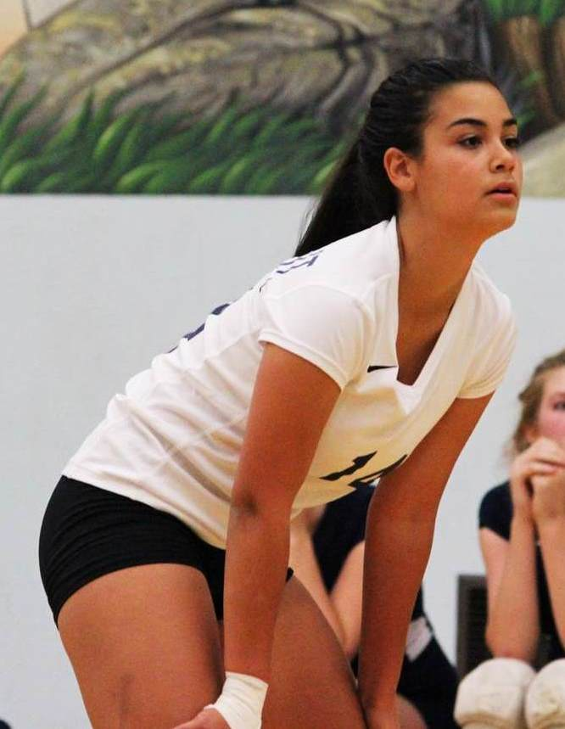
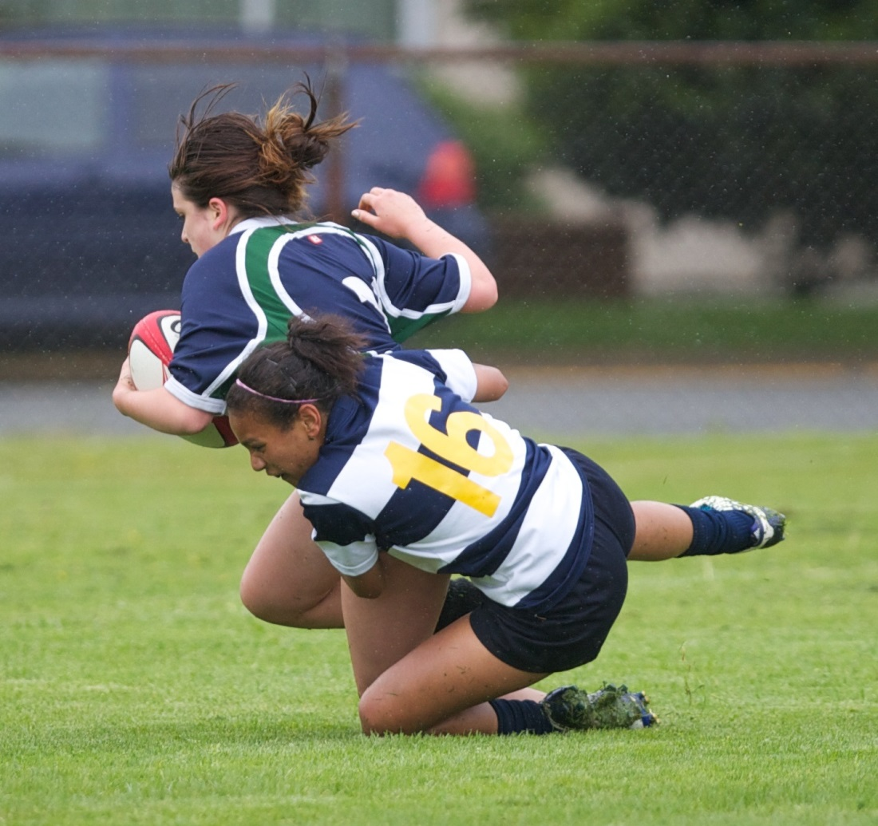
Junior Girls Sportsmanship
Miranda Llewellyn
Julia Muniz

Slide 5
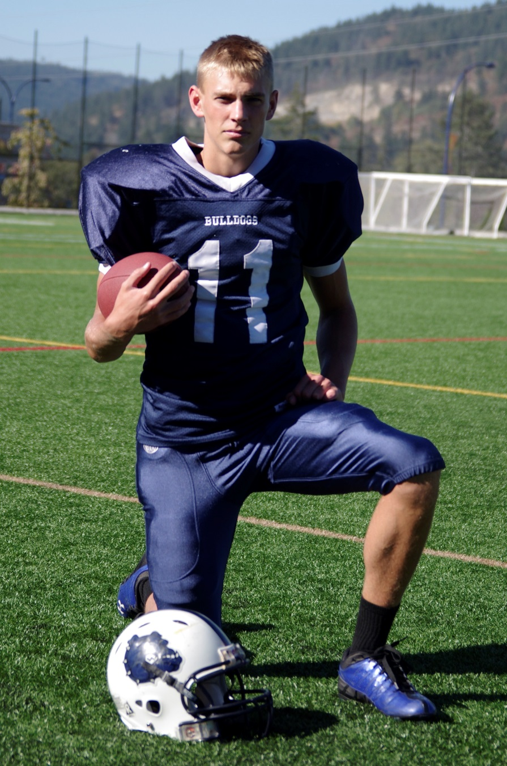
Junior Boys Sportsmanship
Court Boice

Slide 6
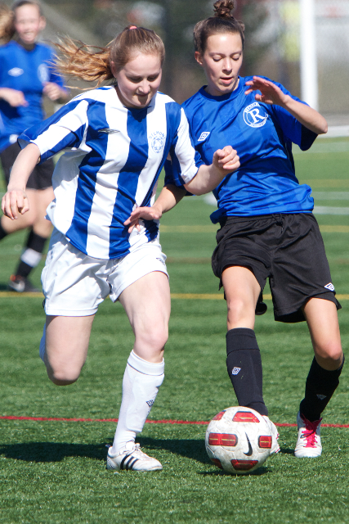
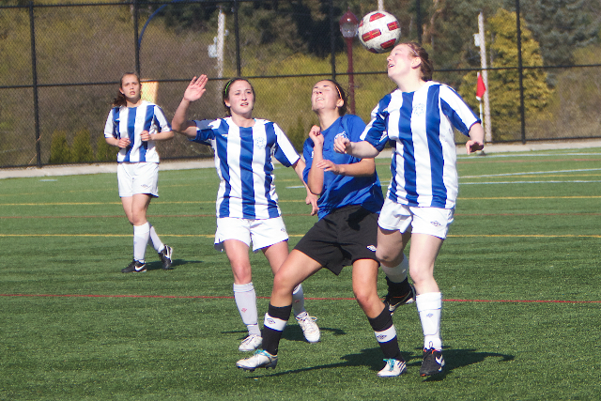
Senior Girls Sportsmanship
Maddie Gill
Ehren Volk

Slide 7
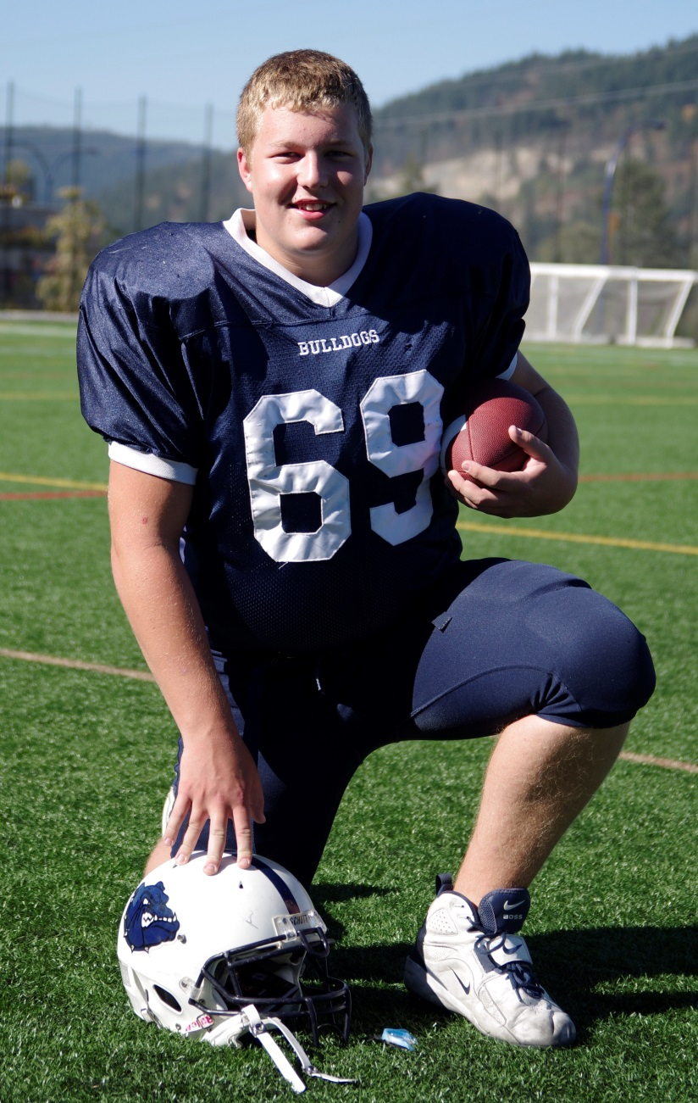
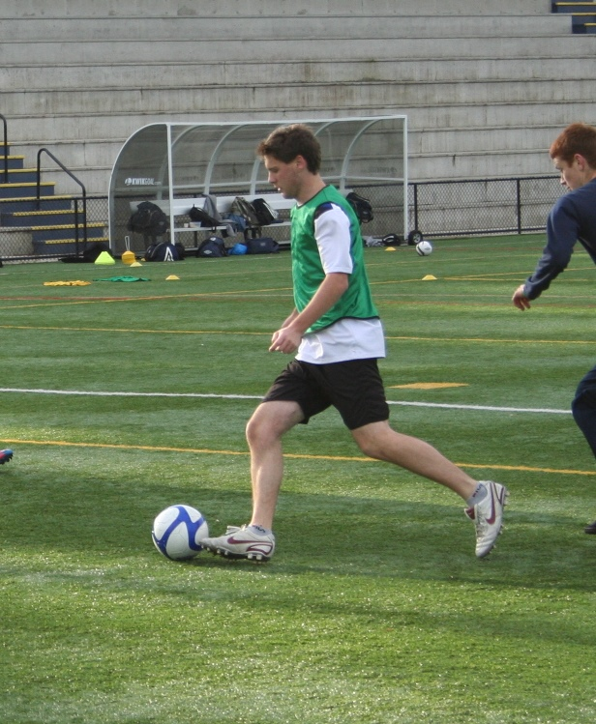
Senior Boys Sportsmanship
Shane Henning
Tristan Forish

Slide 8
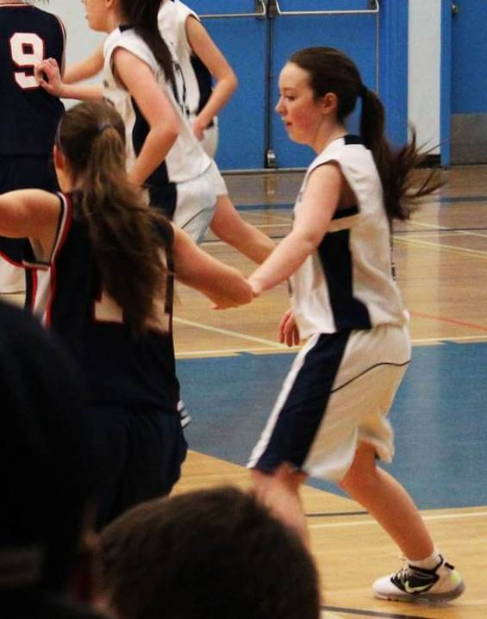
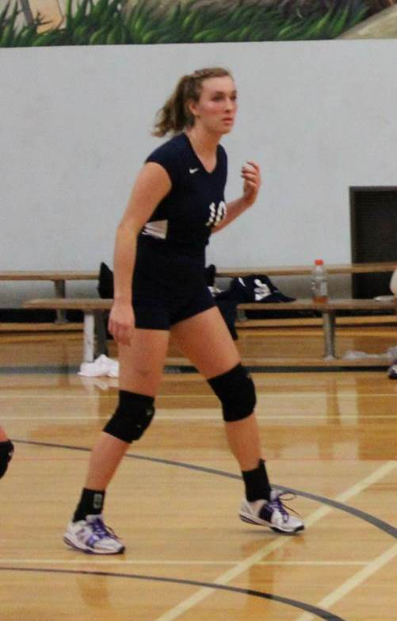
Top Grade 9 Female Athlete
Madison Bullen
Jessica Thomsen

Slide 9
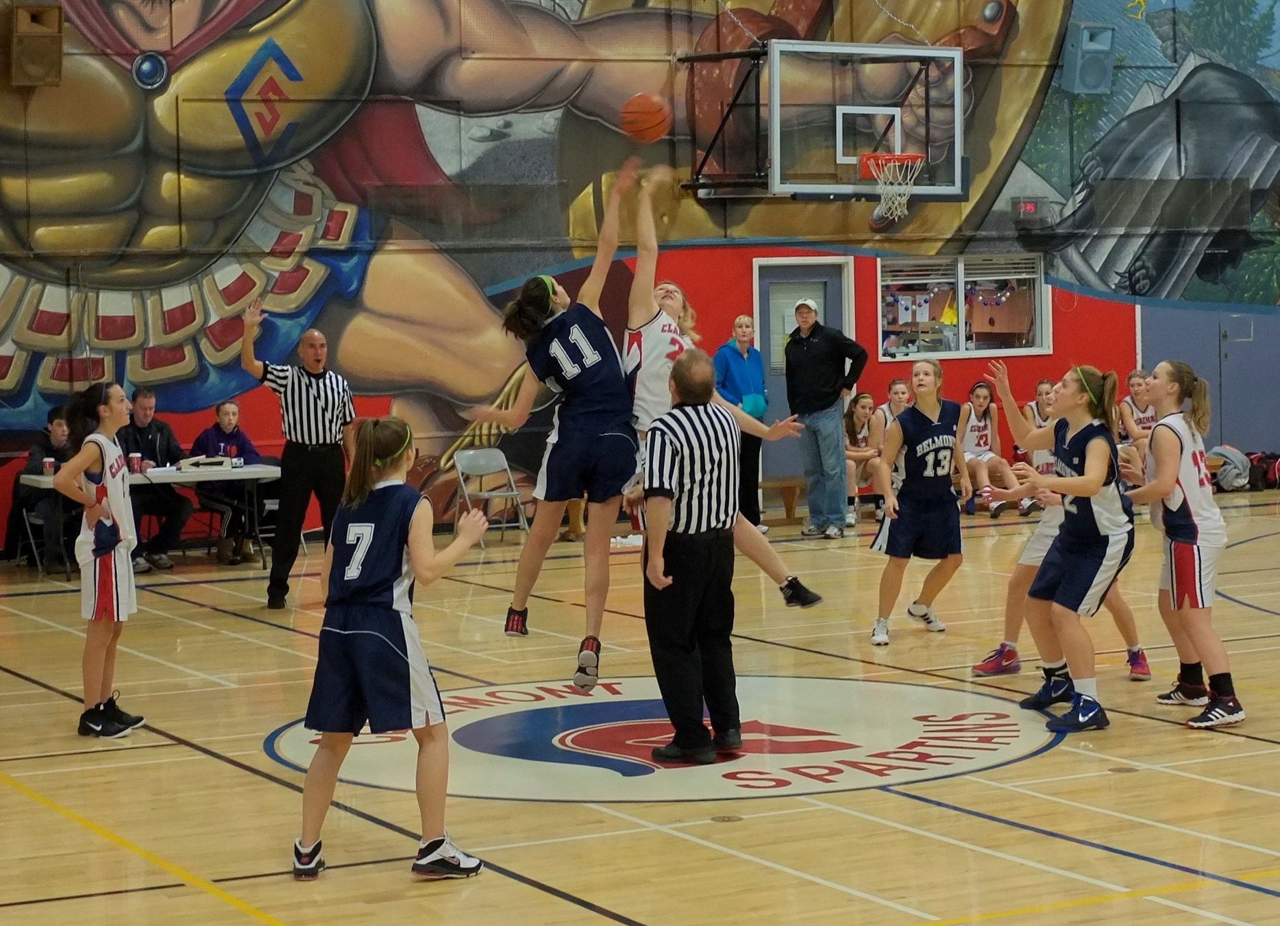
Top Grade 10 Female Athlete
Lindsay Hargreaves

Slide 10
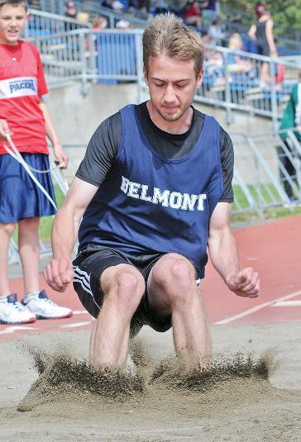
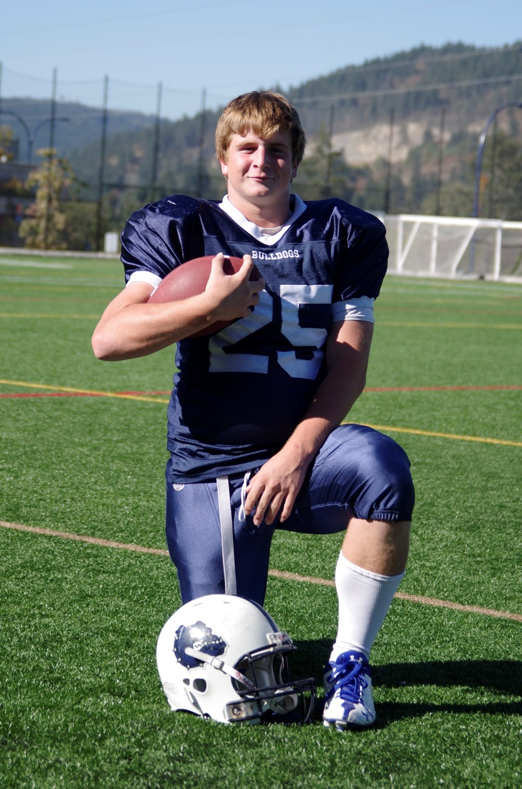
Top Grade 10 Male Athlete
Matt Pastro
Cody Manson

Slide 11
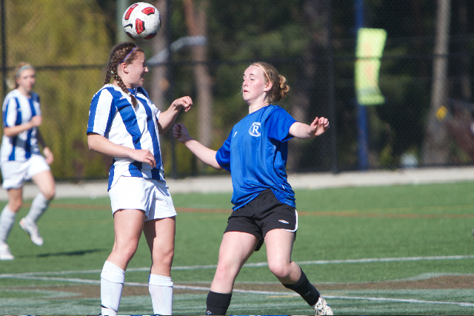
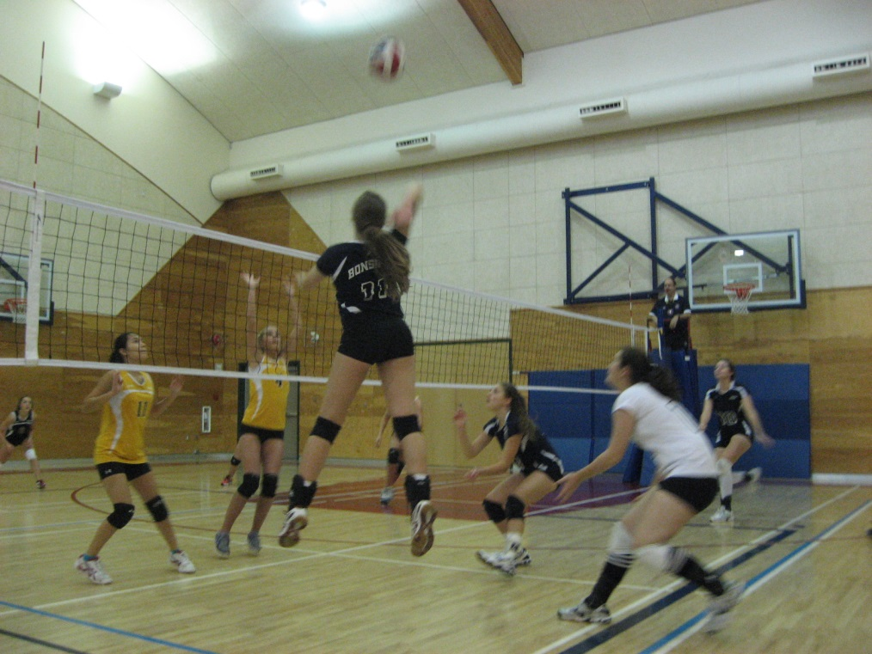
Top Grade 11 Female Athlete
Marisa Livingstone
Tamara Bonsdorf

Slide 12
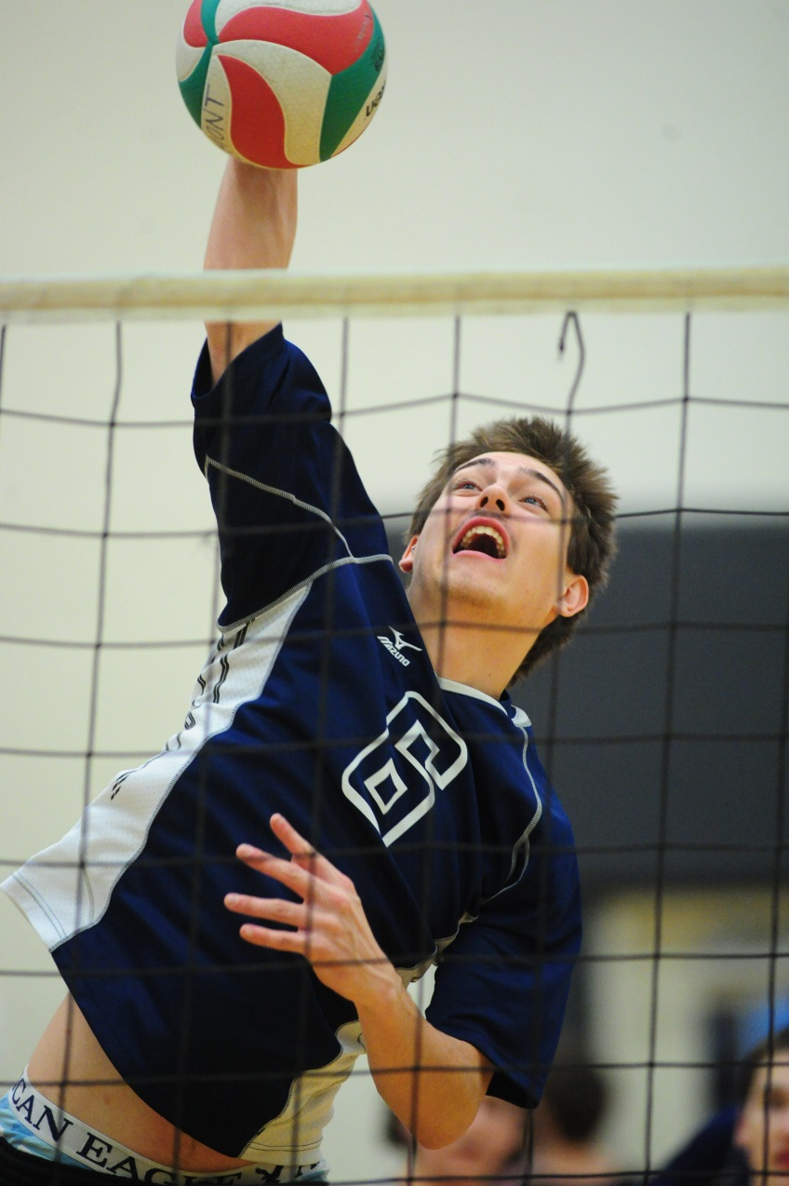
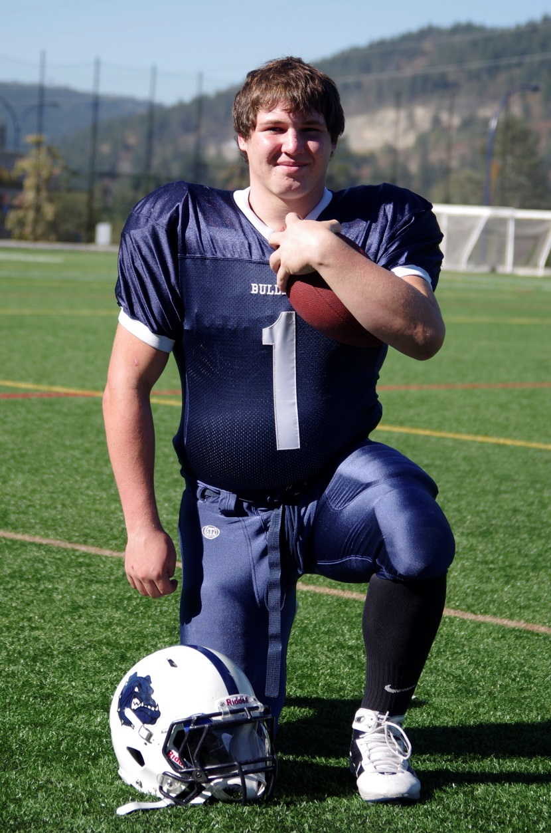
Top Grade 11 Male Athlete
Taran Silas
Sam Varao

Slide 13
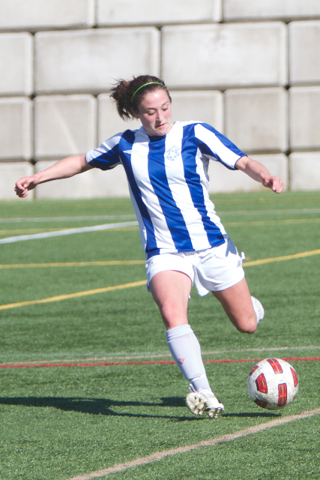
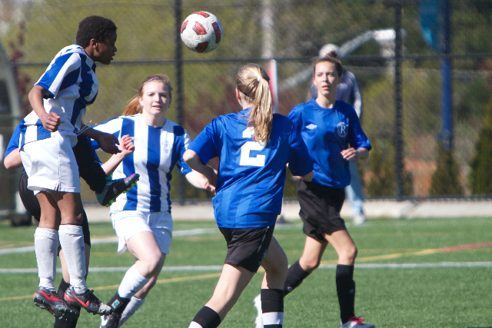
Top Grade 12 Female Athlete
Kathy Forbes
Kristen Livingstone

Slide 14
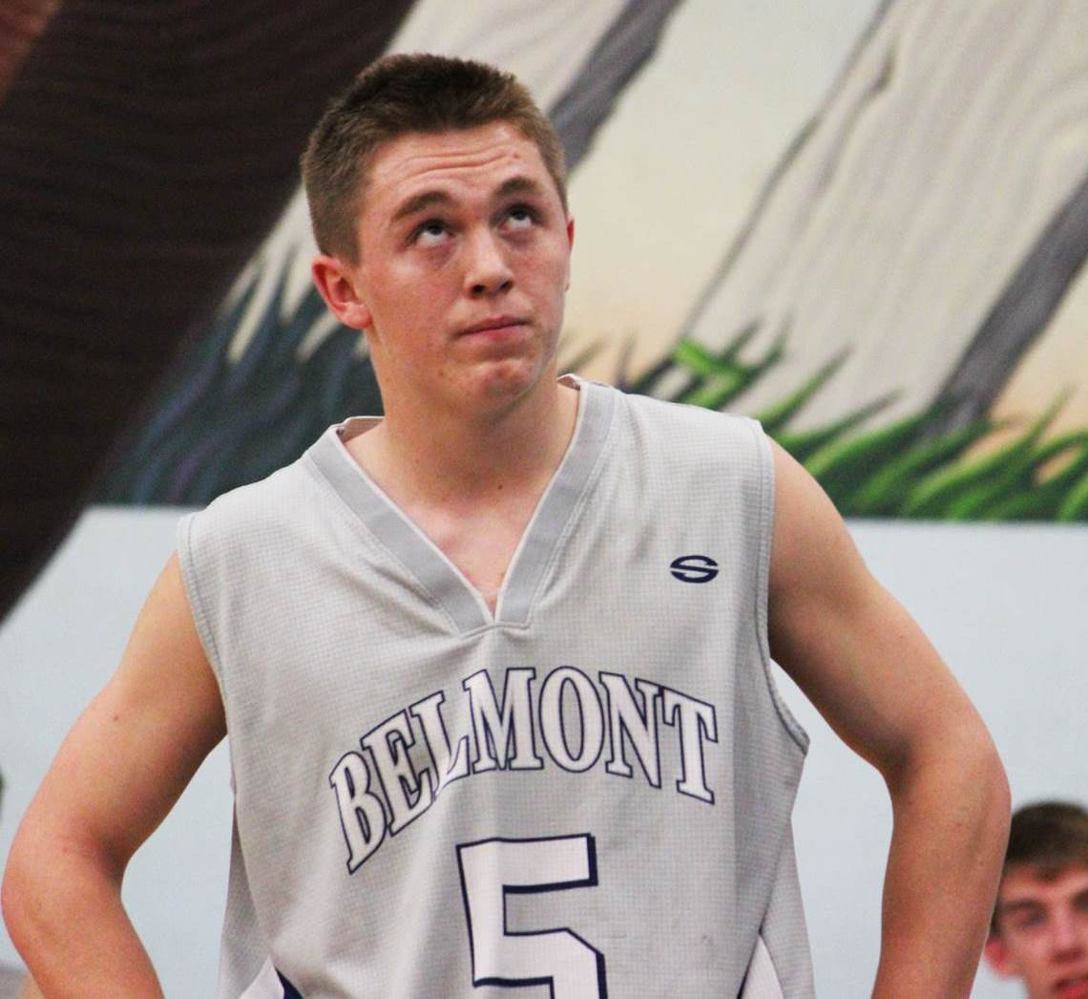
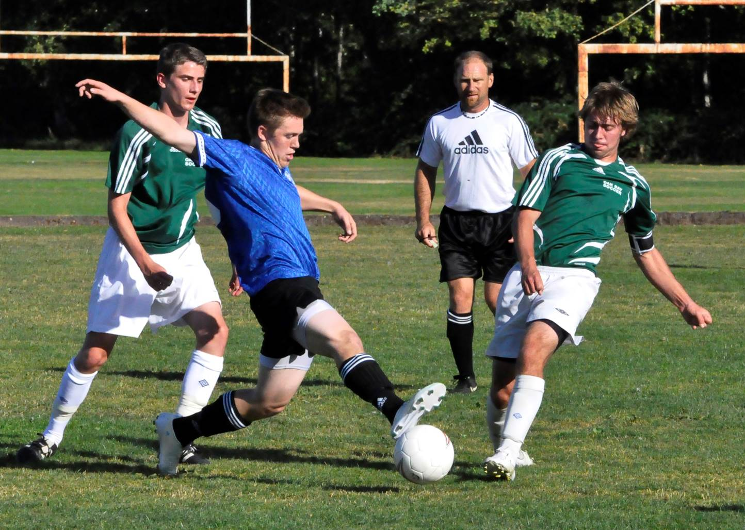
Top Grade 12 Male Athlete
Kane Johnston

