Slide 1
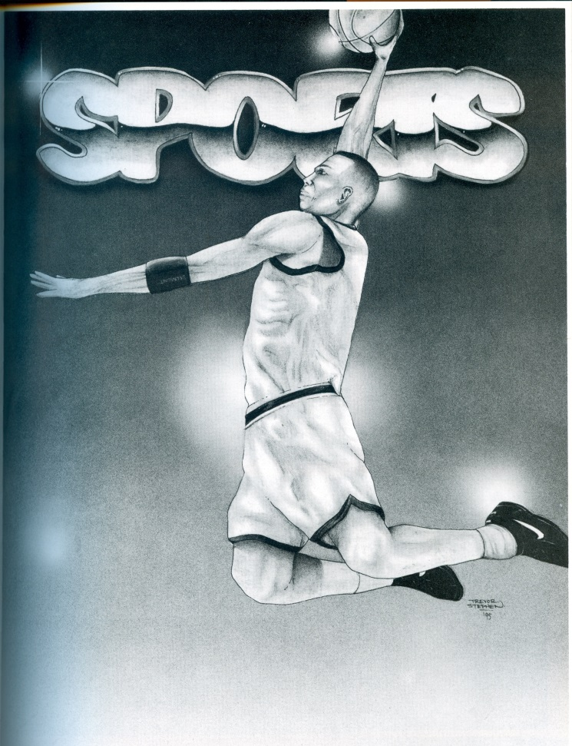
Belmont Sports
From 1990’s
By: Hannah Allen

Slide 2
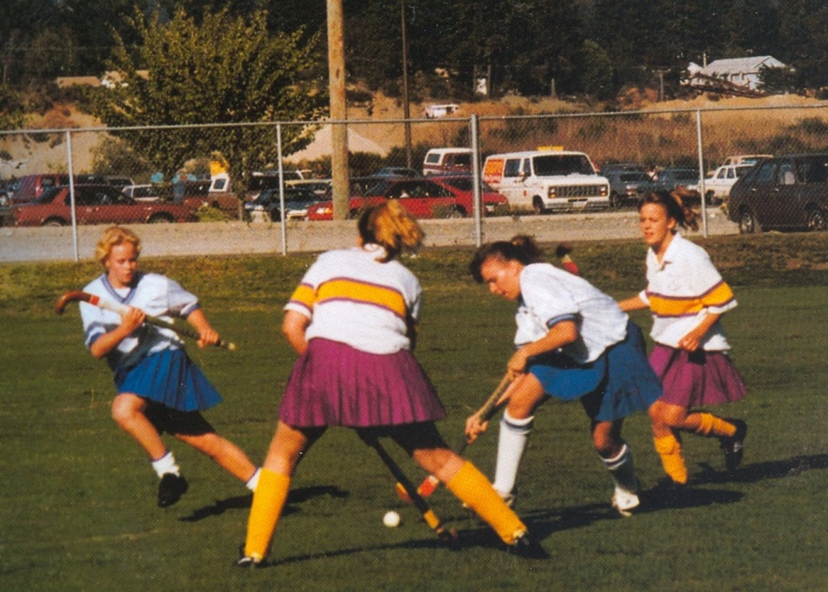
1990 Field Hockey

Slide 3
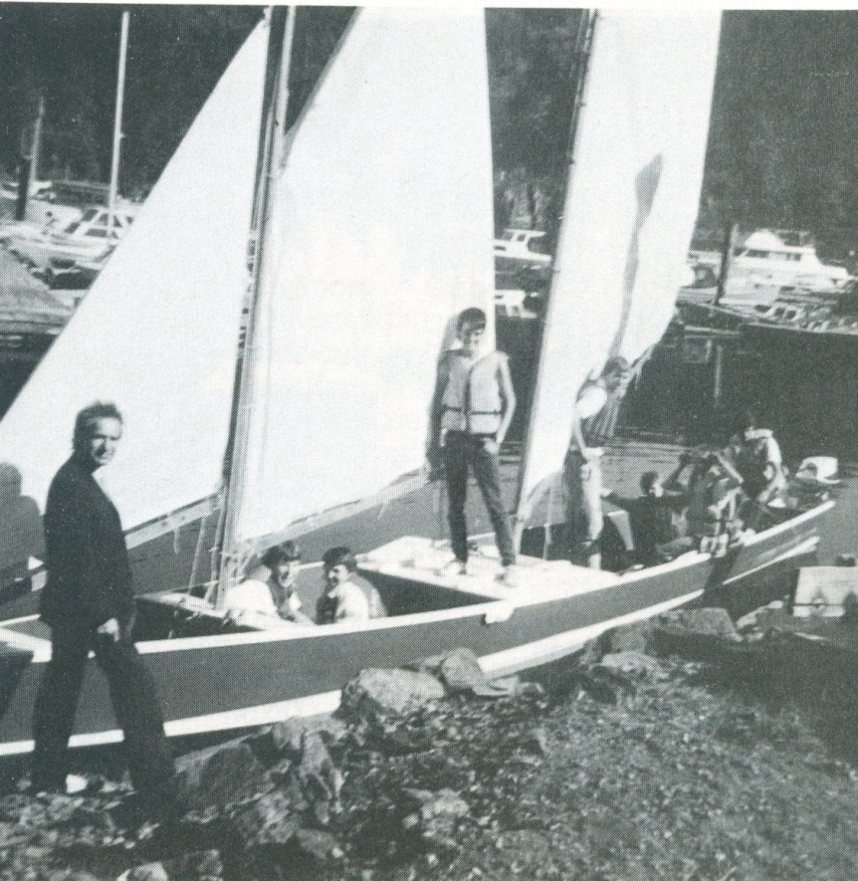
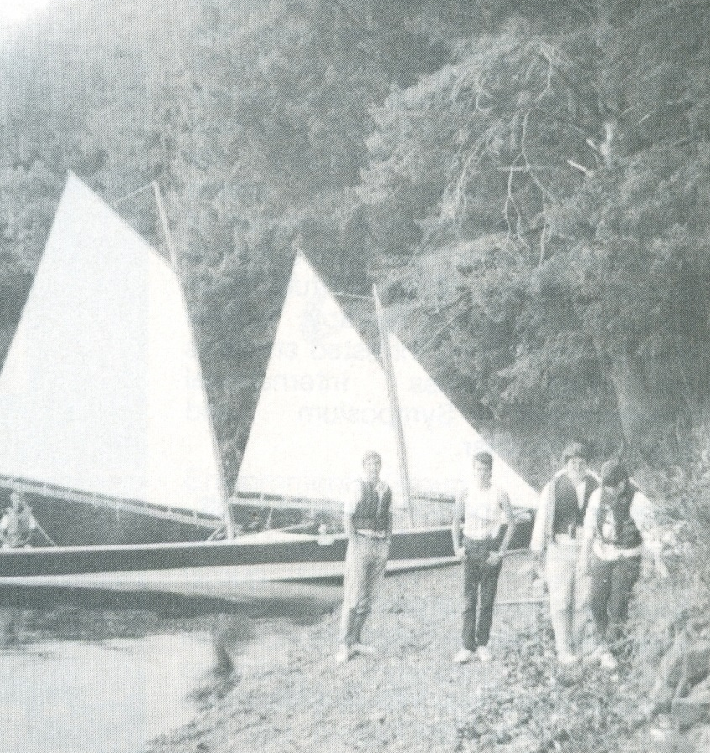
1990 Sailing
The Sailing Club was composed of 18 able bodied (or hope to be) seaman. They planned regular Friday afternoon excursions in the fall and spring, capping their activities with a challenge rare at the end of May. Winter months were spent repairing and re-painting their boats.

Slide 4
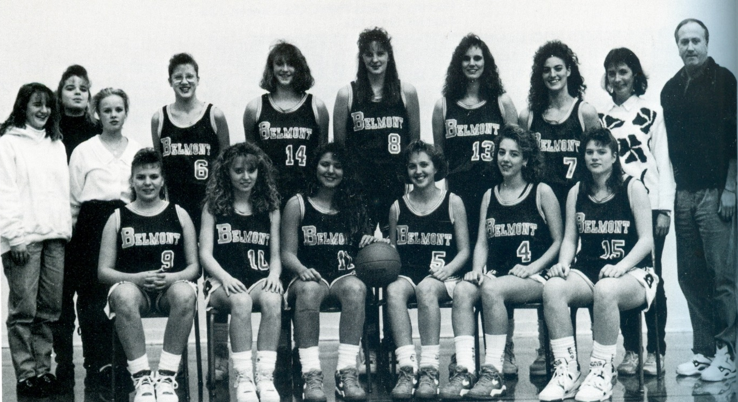

1991 Girls Basketball

Slide 5
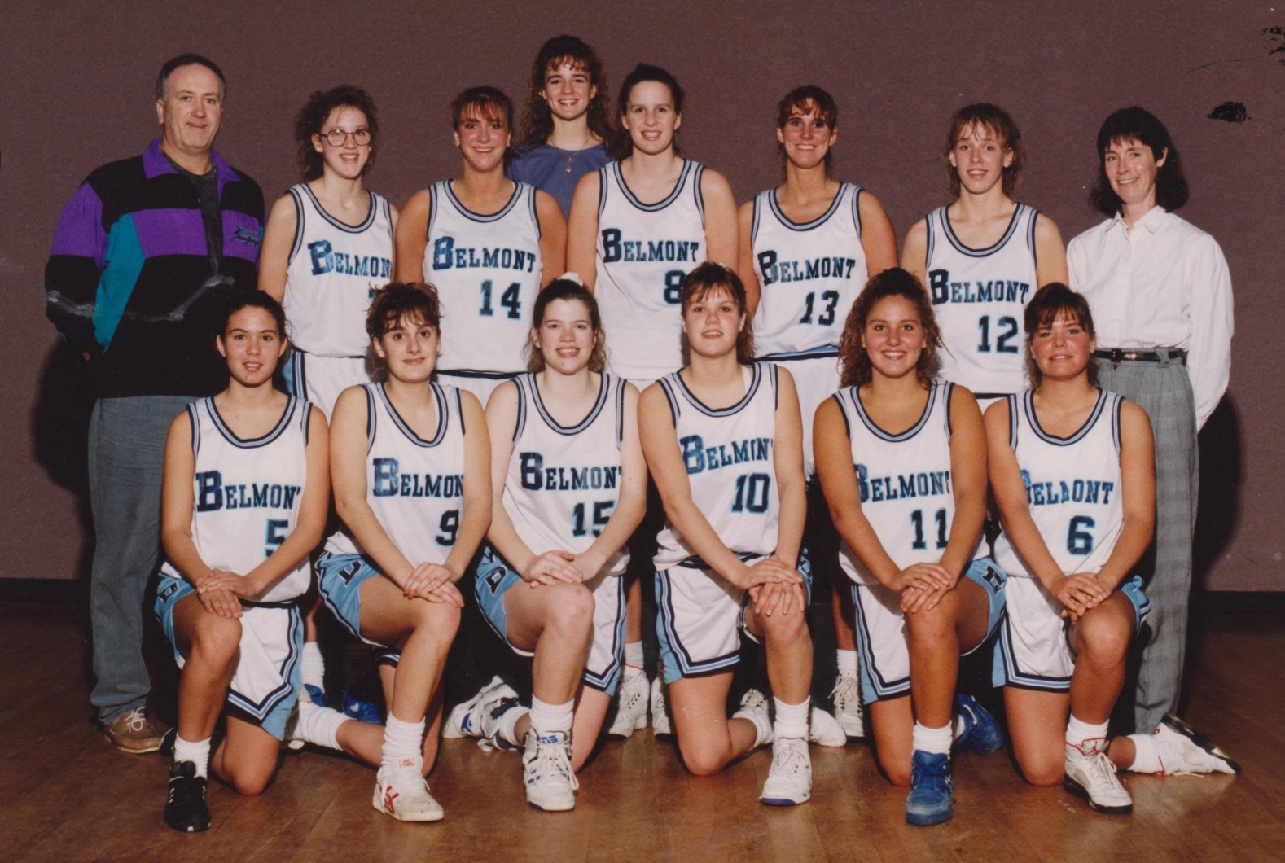
1992 Girls Basketball

Slide 6
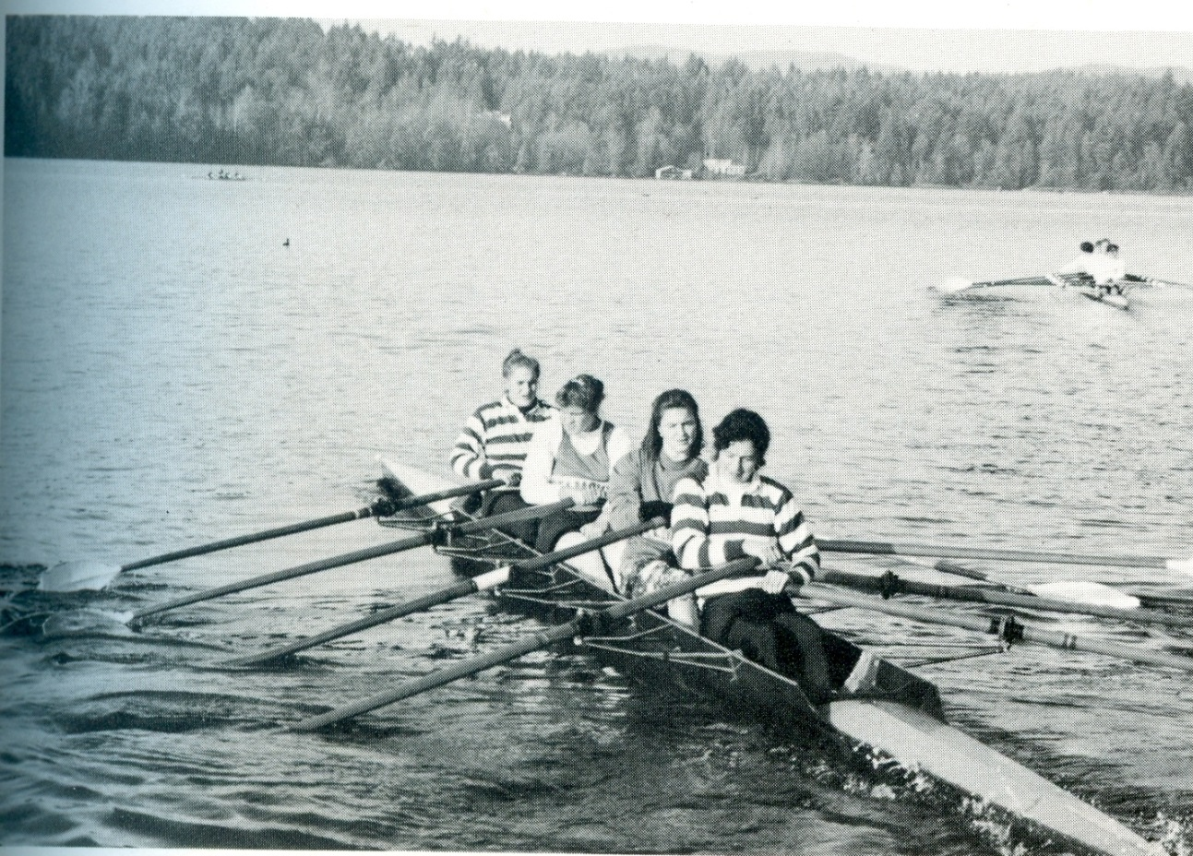

1992 Rowing
Kristen would one day row for
Canada at the Olympics

Slide 7
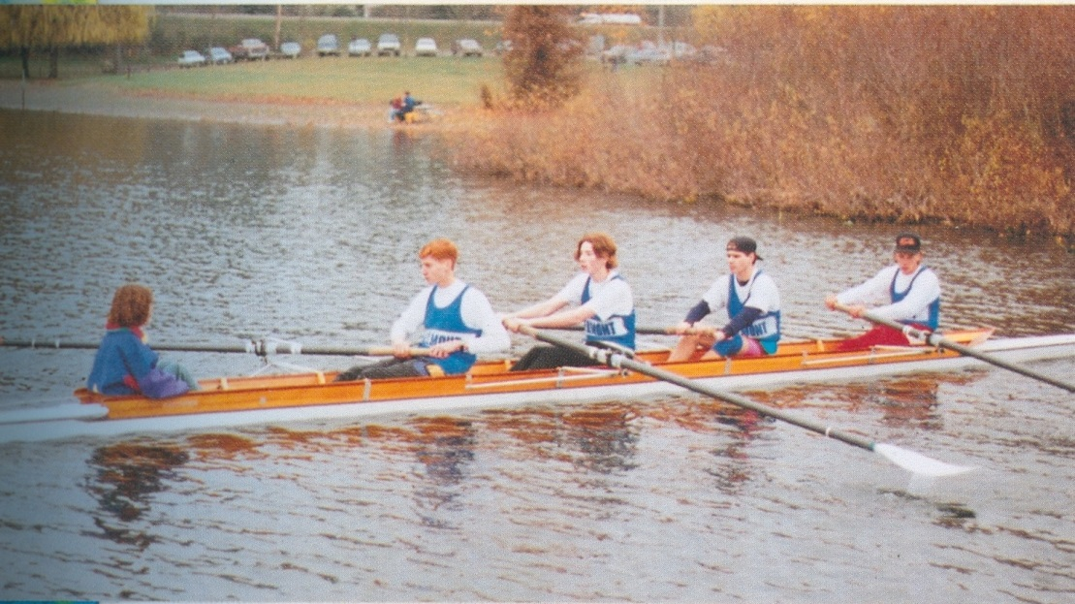
1993 Rowing
Practicing on Elk Lake are Coxswain Leah Cavanaugh, Brian Willing, Brant Felker, Conrad Dombrowski and Rob Artibise

Slide 8
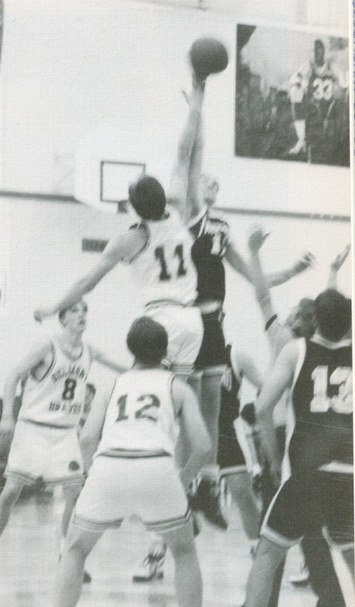

1994 Boys
Basketball
Taking jump ball is Cameron Burton, as Christ Orr and Dennis Phillion prepare to receive the ball.
Mike Crowe making a pass.

Slide 9
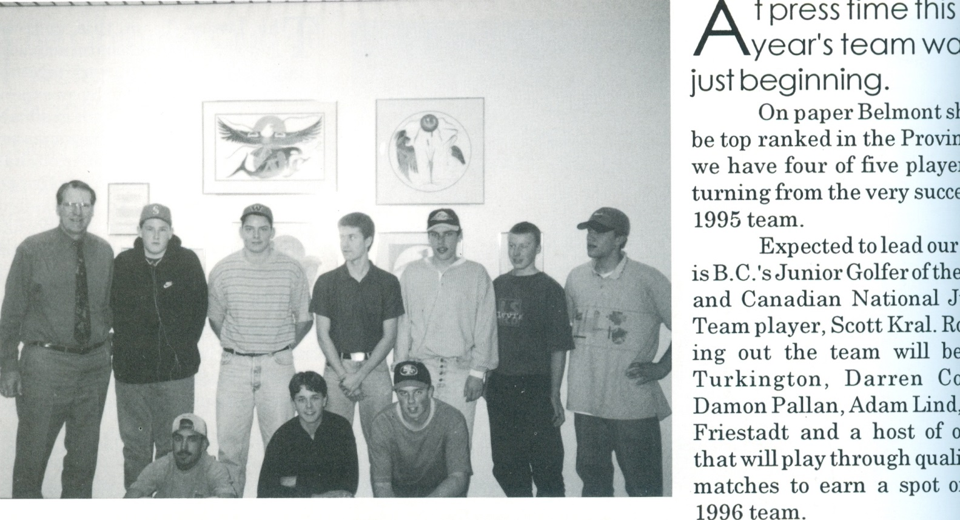
1996 Golf Team

Slide 10
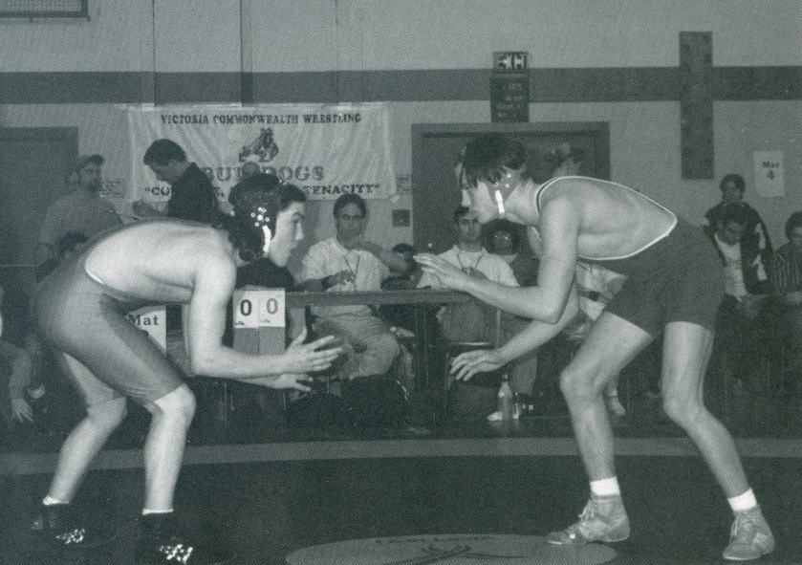

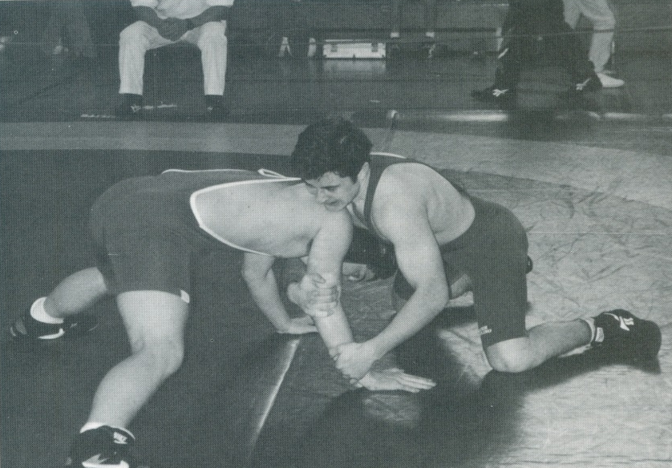

1995 Wrestling
Shane Prieur set to square off his opponent.
Grappling and holding on to victory is Rodney Marseille

Slide 11
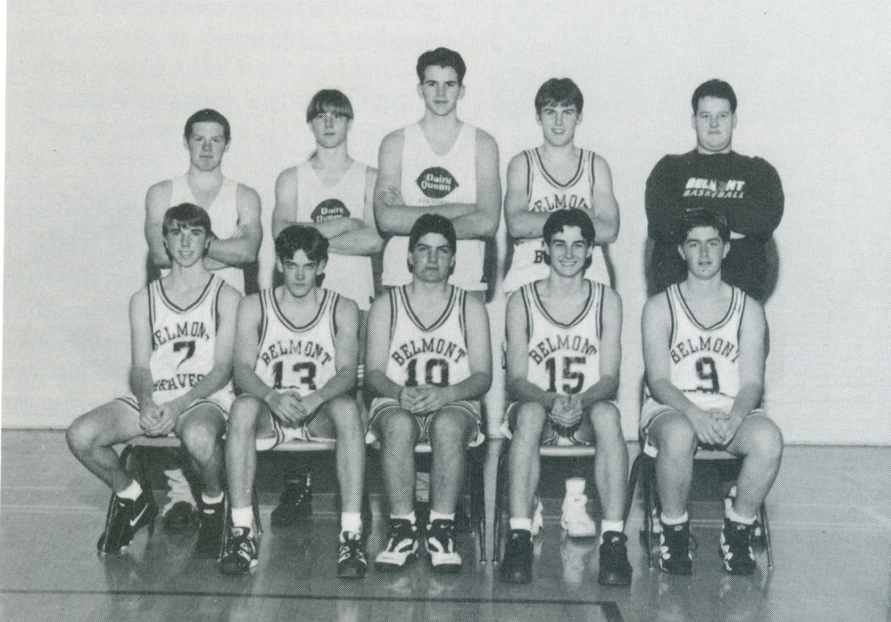
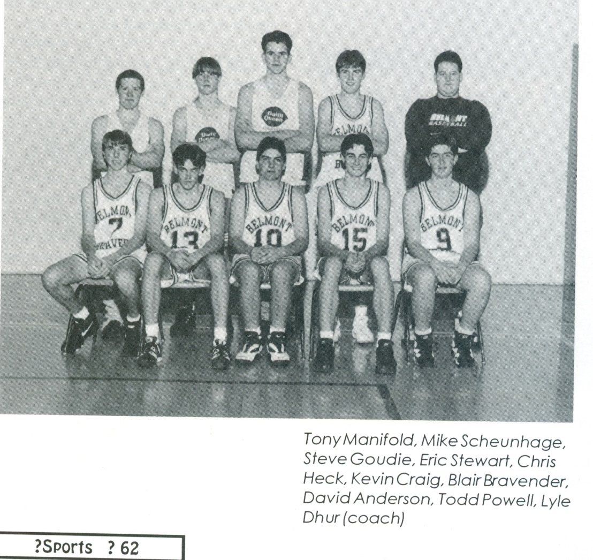
1996 Basketball

Slide 12
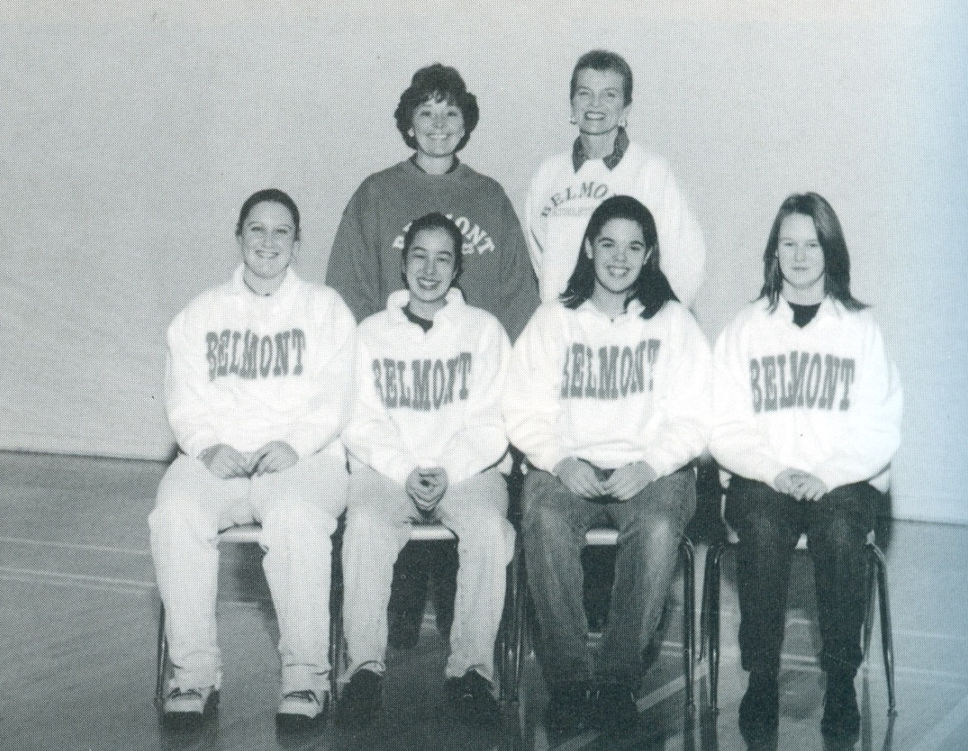
1996 Curling

Slide 13
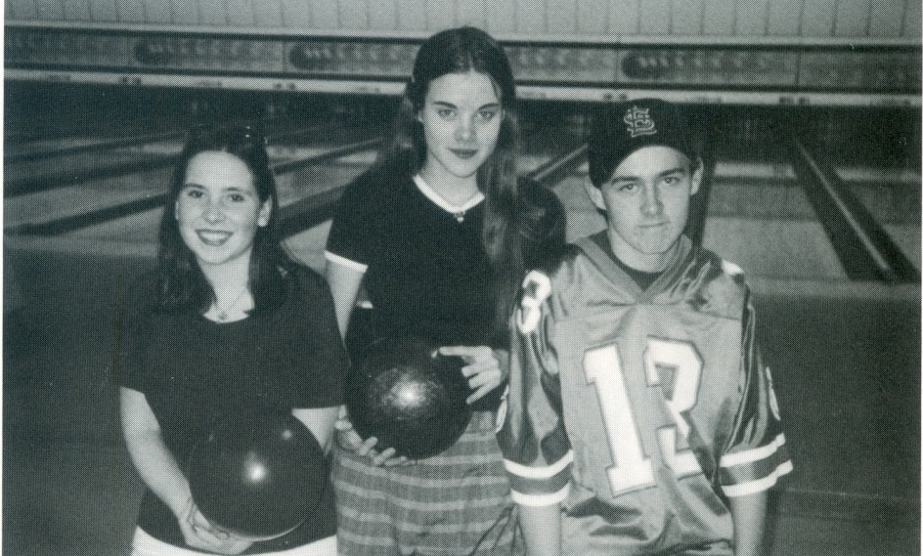


1997 Bowling Team

Slide 14
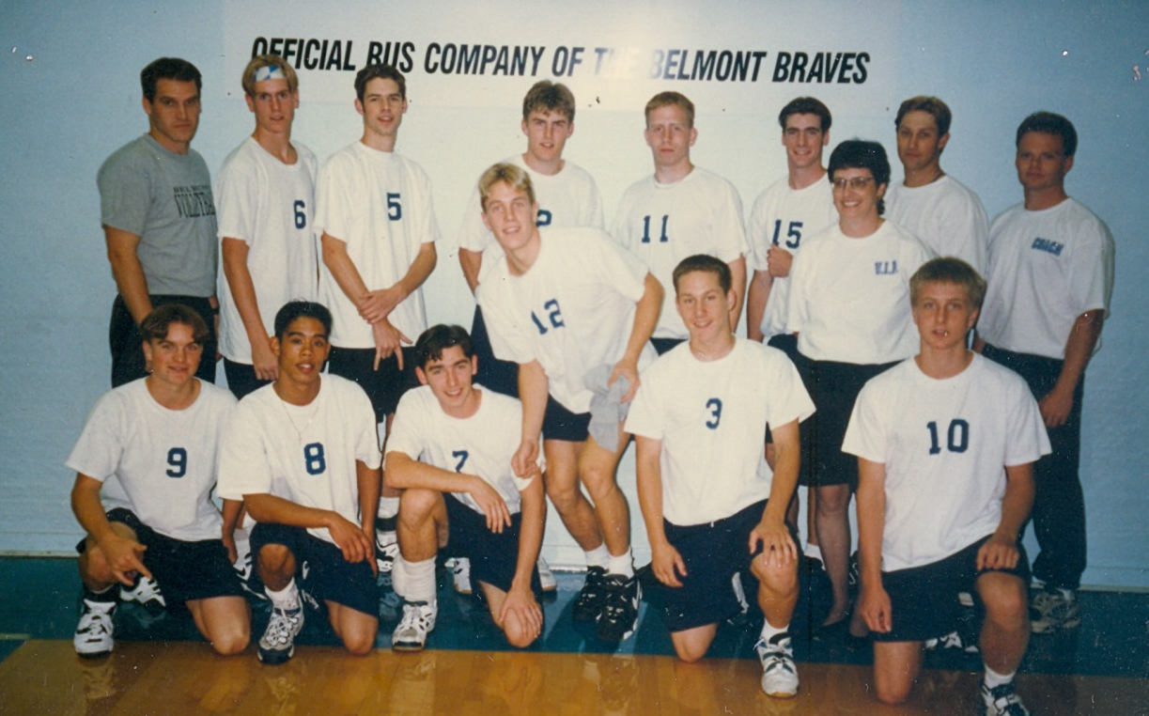
1997 Volleyball

Slide 15
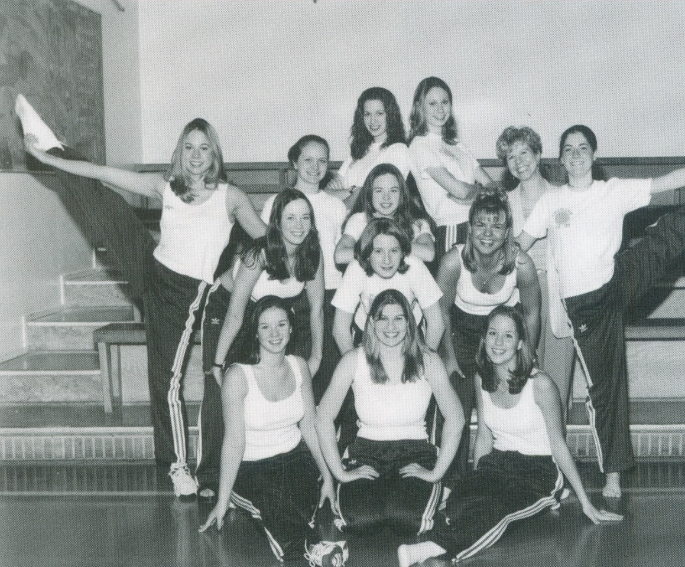
1997 Dance Team

Slide 16
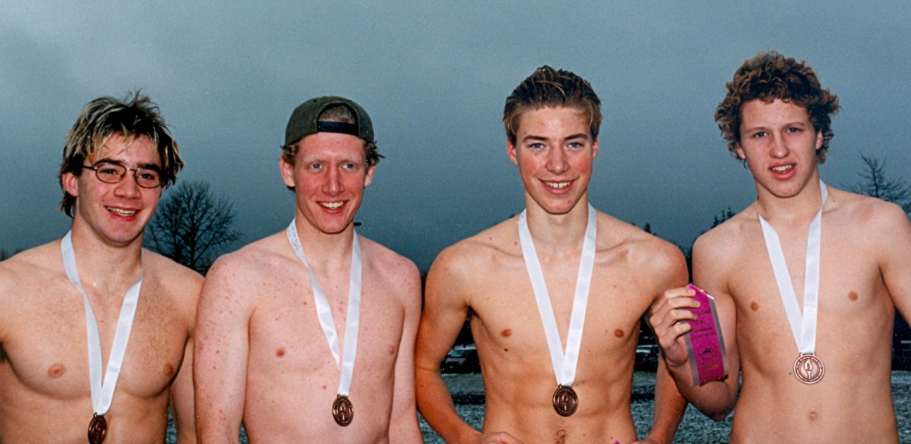
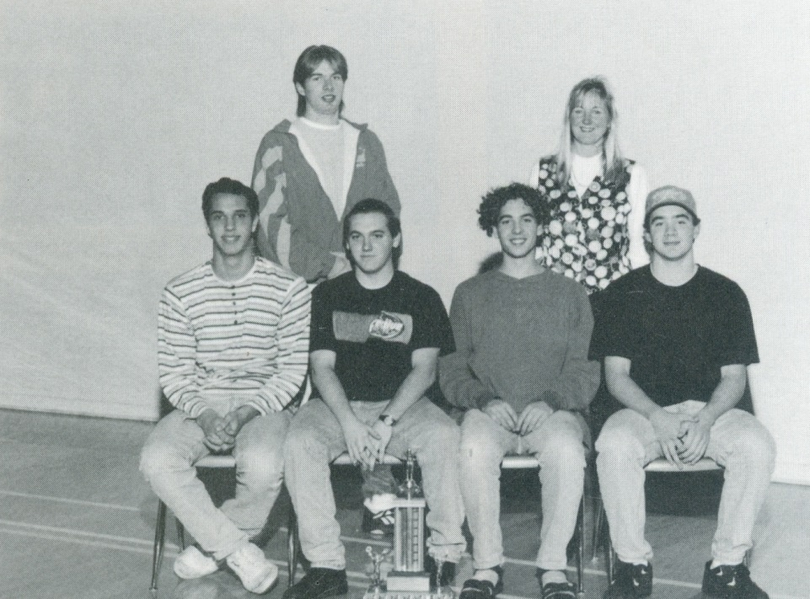
1996-97 4 by 400 meter freestyle relay team: BC Champions

Slide 17
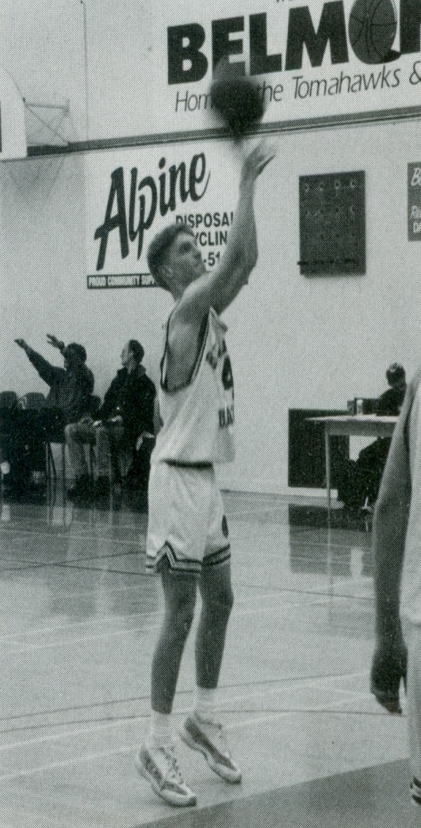

1997 Boys Basketball

Slide 18
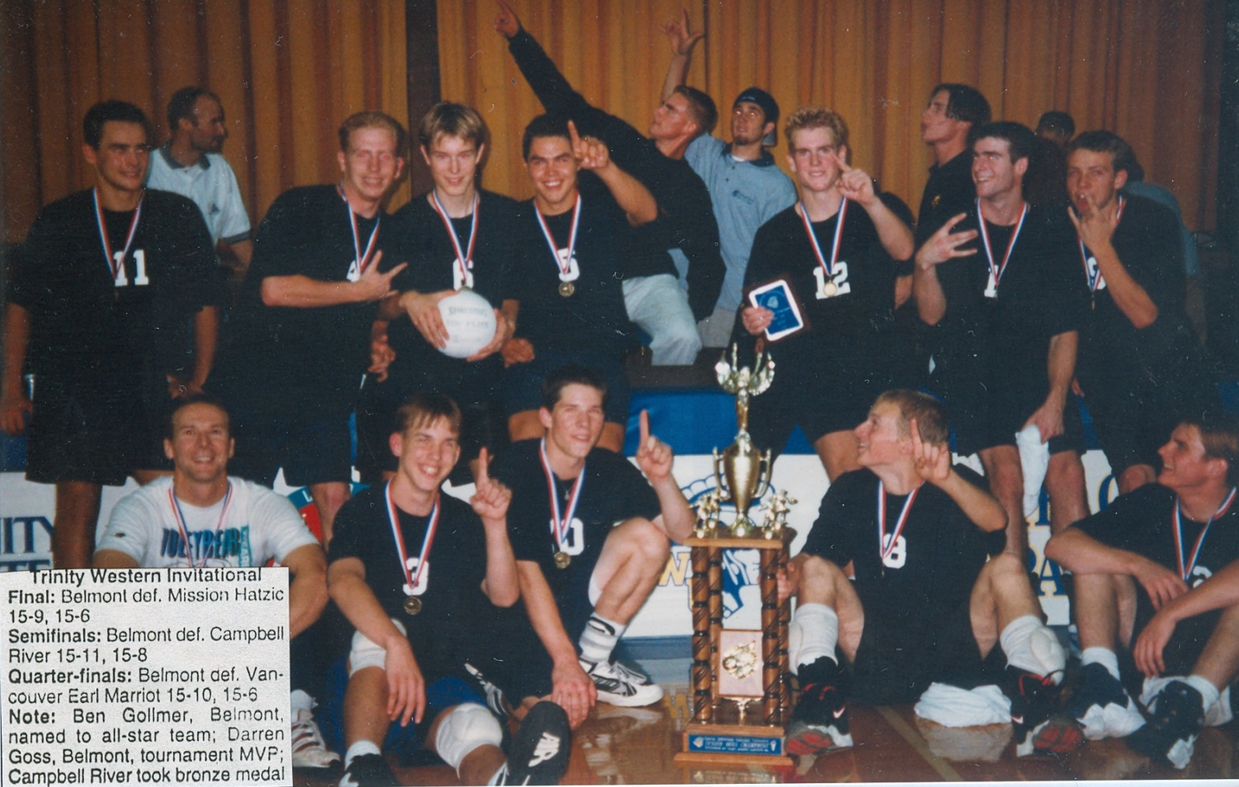
1998 Boys Volleyball

Slide 19
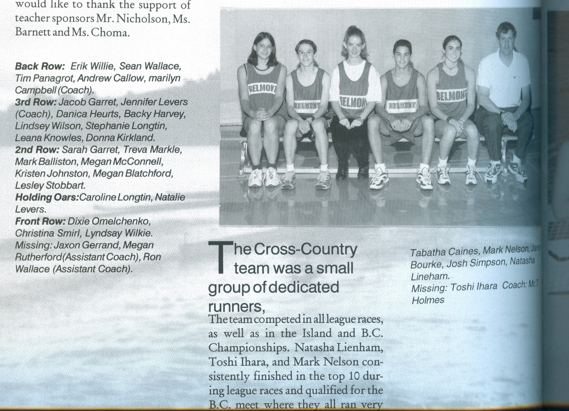
1999 Cross Country

Slide 20
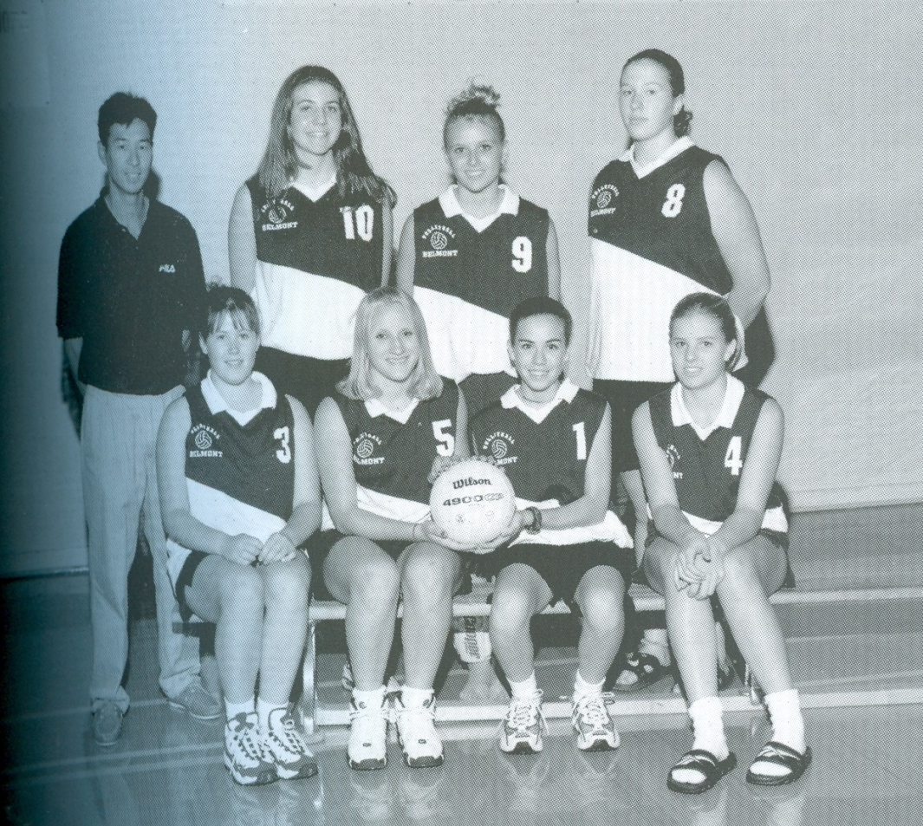
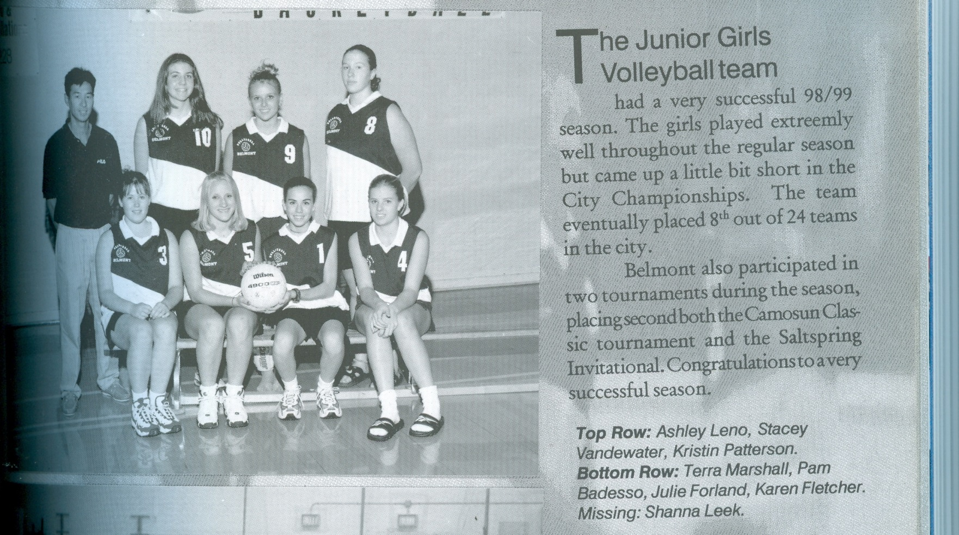
1999 Girls Volleyball

